Slide 1
Where and when the fly mushroom body reshapes odor relationships
ANALYSIS REVIEW
Figure 7: PN bouton and KC claw representational geometry at every frame of the odor response, and the analyses behind the claims.
Remy Yang · Caltech · October 2026
17 odors · 136 odor pairs · PN boutons n = 5 flies · KC claws n = 4 flies
Section 1 of 6 · What Figure 7 asks, and the data
Notes:
This deck summarizes the Figure 7 RDM-timeseries analysis for a soundness check. Every number is from the analysis report (rdm_timeseries_analysis_report.html); the interactive explainer page recomputes most of them in the browser from the per-fly data. Slide 3 defines the terms and slide 5 gives the findings at a glance. Slides 23–24 summarize the findings and APL trees; slides 25–26 list the caveats and the specific questions we would like answered.

Slide 2
Outline
1
What Figure 7 asks, and the data
Terms; four questions and their answers; the data; the key definition
slides 3–7
2
Is the difference real, and what does it track
Split-half replication; why a split-fly instrument; claws track the KC somata holding boutons fixed
slides 8–10
3
When the structure appears
Cluster agreement over time; correlation with ORN and somata at every frame; decorrelation vs reliability
slides 11–13
4
Which pairs move, and the wiring models
Odor shift vs pair shift; who moves and when; what the connectome prior adds and whether claws follow it
slides 14–19
5
Checks on the statistics
Why Pearson and the attenuation correction; robustness to the somata reference and fit scale; the toolkit
slides 20–22
The findings and APL trees; what limits the claims; seven questions for the theory side; where the report, page and code live
6
Summary, caveats and open questions
slides 23–27
Figure 7 analysis review · 2
Section 1 of 6 · What Figure 7 asks, and the data
Notes:
The bar at the bottom of every slide has one segment per section: completed sections in pale blue, the current section filling up slide by slide, upcoming sections in grey; the footer names the current section.

Slide 3
One name per quantity, used on every slide
TERMS
Term | Meaning
RDM, similarity | Odor × odor matrix of Pearson r between population responses; 17 odors give 136 pairs
z units (SD) | Values standardized across the 136 pairs: mean 0, SD 1
Claws beyond E[claws | boutons] | Claw similarity minus its linear prediction from same-time bouton similarity
Odor part | One value per odor, aᵢ; a pair’s odor part is aᵢ + aⱼ
Pair part | What is left: the change specific to that pair
Odor-part drift | How the odor part changes over the first 1–3 s of the odor
Split-half reliability | r between the matrices of two disjoint halves of the flies
Noise-corrected stability | Cross-time r ÷ same-time reliability; 1 means no change
Uniform, hemibrain model | Model KC responses from random PN → KC wiring, or from connectome-weighted wiring
Between ÷ within | Different-odor r divided by same-odor (trial-to-trial) r
Figure 7 analysis review · 3
Section 1 of 6 · What Figure 7 asks, and the data
Notes:
Residuals (“Y beyond E[Y | X]”) and plain differences (“X→Y change” = z(Y) − z(X)) are named differently because a difference also carries regression to the mean. The models are Figure 6’s uniform_tom and hemibrain_wd20_tom; both are driven by ORN-like input and give one response per odor, so they are static. Every fit was repeated with a quadratic term.

Slide 4
The question Figure 7 asks
THE QUESTION
Figure 6’s static step correlations point to the PN-bouton → KC-claw step, but cannot tell reorganization from noise or compression, show its direction, or time it. Figure 7 tests that step directly, asks whether the reorganization is present when the response begins or builds up during the odor, and which odor pairs it moves.
Where
What it tracks
When
Which pairs
Is the claw geometry different from the bouton geometry it is built from, beyond compression?
Does the claw-specific part look like the KC somata, like a connectivity model, or like neither?
Is it there at the first reliable frame, or does it emerge over 1–3 s, and with what time course?
Which odor pairs move, is the movement in the odor part or the pair part, and does it match the hemibrain prior?
Figure 7 analysis review · 4
Section 1 of 6 · What Figure 7 asks, and the data
Notes:
The manuscript’s framing: Figure 6’s step correlations (ORN → PN boutons 0.83, PN boutons → KC claws 0.80, KC claws → KC somata 0.84; Δr to ORN ≈ 0.10, odor bootstrap just clears zero) point to the bouton-to-claw step but cannot separate reorganization from noise or compression or give it a direction. Figure 7 tests the step directly and adds time. The four questions on this slide map onto report sections 3.2, 3.3, 3.4–3.6 and 3.8.

Slide 5
Four questions, four answers
FINDINGS AT A GLANCE
Where
What it tracks
When
Which pairs
Claws differ from boutons beyond compression and noise; the difference replicates across fly halves.
The KC somata, not ORN input; partly predicted by either wiring model.
In place at 0.5 s and stable to 3 s. A fast shared decorrelation changes the level only.
A stable pair part (60–67 %) and a drifting odor part (32–40 %) that carries the hemibrain bias.
The KC transformation is already at the claws, before the spike threshold.
Figure 7 analysis review · 5
Section 1 of 6 · What Figure 7 asks, and the data
Notes:
Numbers behind each card: split-half r 0.56–0.60 for claws beyond E[claws | boutons]; somata coefficient +0.48 (p 0.0001), ORN −0.08; either wiring model r 0.23–0.37 for the pair part; pair-part stability 0.91–0.98; odor part follows hemibrain − uniform at 0.54–0.62 during the sustained odor. The findings tree near the end (slide 23) walks through the same answers with what each one ruled out.

Slide 6
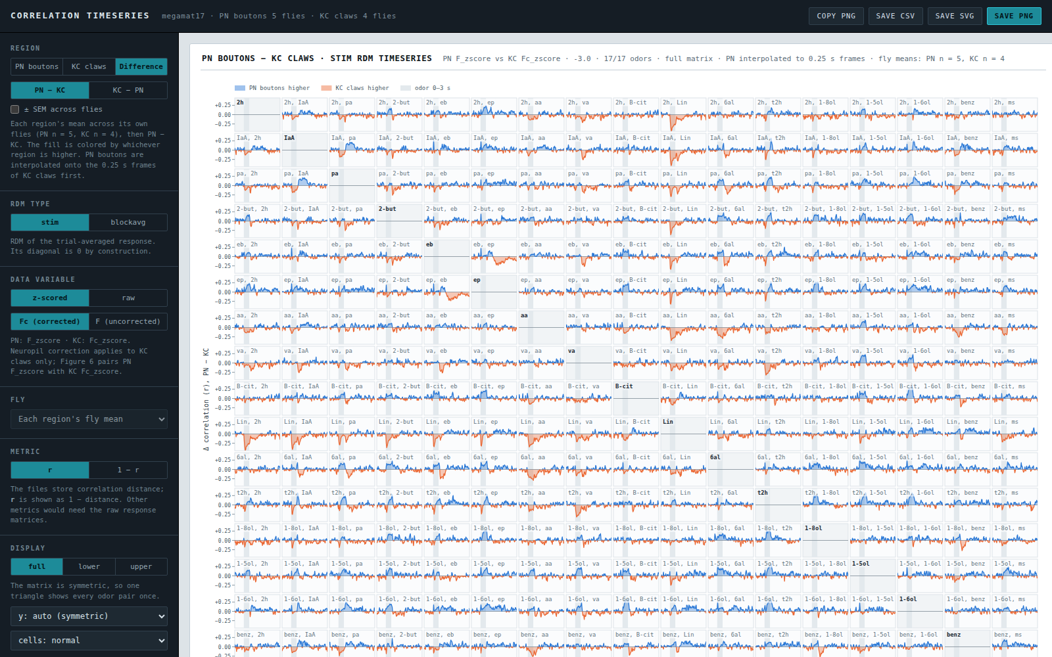
One correlation matrix per fly, per frame
THE DATA
Region | PN boutons | KC claws
Flies | 5 (GH146) | 4 (calyx)
Frame | 0.2 s | 0.25 s
Trials per odor | 3 | 3
Variable | F_zscore | Fc_zscore
Odor on | 0–3 s | 0–3 s
Each odor’s response at a frame is a vector over ROIs; Pearson r between two odors’ vectors is their similarity: 136 pairs per matrix.
References from other flies: ORN and KC-somata matrices, and the uniform and hemibrain models.
Dashboard, difference view: PN boutons − KC claws per pair over time (grey = all pairs; mean near zero throughout).
Figure 7 analysis review · 6
Section 1 of 6 · What Figure 7 asks, and the data
Notes:
The two regions come from different animals, so there is no within-animal pairing: reproducibility is always tested across fly halves. Bouton frames are interpolated per fly onto the claw frame times before any comparison. The manuscript’s PN terminals are n = 6; the timeseries have 5 (one acquisition dropped); Figure 7 reports n = 5.

Slide 7
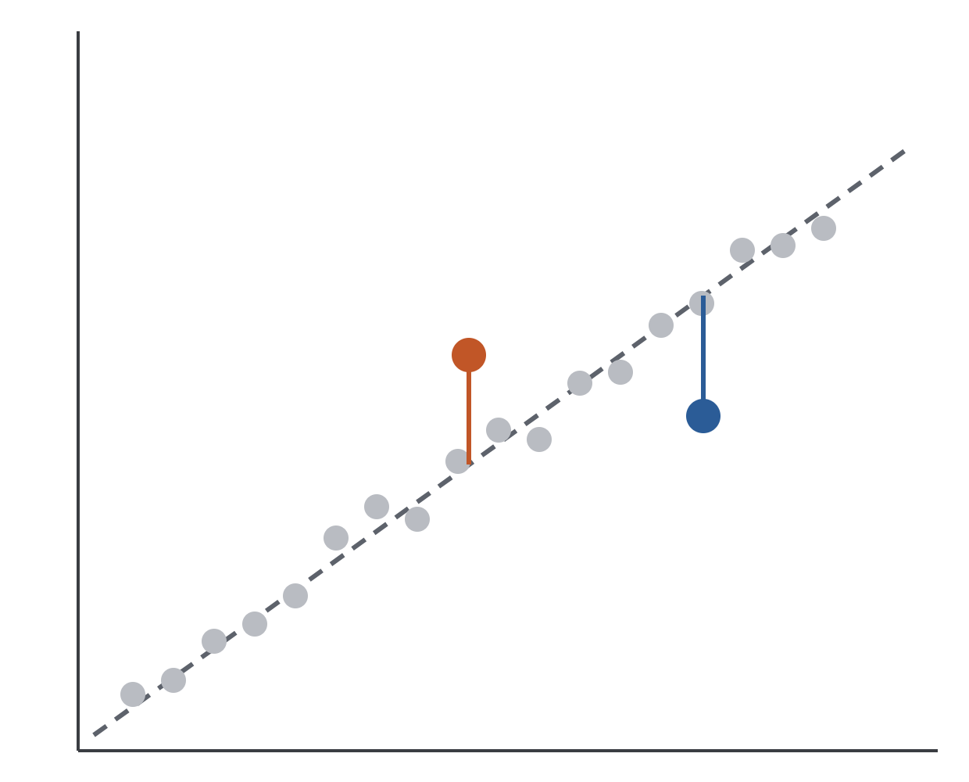
Claws are a compressed copy of boutons, with exceptions
THE KEY DEFINITION
At each frame, plot every odor pair’s claw r against its bouton r and fit a line (dashed). During the odor the slope is about 0.80: claws compress bouton similarity.
Most pairs sit near the line. The vertical distance from the line is what the rest of the deck is about.
Claws beyond E[claws | boutons]
Above the line: more similar in claws than boutons predict. Below: less similar. Computed on z-scored values across the 136 pairs.
Schematic · x: bouton r · y: claw r · one dot per odor pair
Figure 7 analysis review · 7
Section 1 of 6 · What Figure 7 asks, and the data
Notes:
The dots are illustrative, not data; the per-pair time courses with the expected-from-boutons line are in the Figure 7 asset (the 17 × 17 grid). The linear fit is chosen deliberately: slope = compression, residual in interpretable units. The relation is slightly convex (quadratic F = 27.8, p < 0.001; cubic ns), the signature of a sparsening nonlinearity; a quadratic fit lowers the headline numbers by up to 0.12 and keeps 7 of the 11 top movers (report §3.8.2).

Slide 8
The pair pattern of the difference replicates across independent flies
IS IT REAL?
r = 0.49
r = 0.57
0 of 136
Split-half replication
Beyond compression
Single pairs: no power
PN boutons − KC claws computed from disjoint fly halves (PN 2 | 3 × KC 2 | 2, 30 splits), correlated across the 136 pairs. Odor-label permutation p ≤ 0.0005. Holds in every window.
The part of claw similarity not linearly predicted by boutons also replicates across fly halves, so the difference is not just the 0.80 × compression.
Per-pair Welch t (5 vs 4 flies), BH-corrected: no pair at q < 0.05, three at q < 0.10; 19 pairs at p < 0.05 vs ~7 expected. Odor-level tests carry the weight.
Not organized by chemical class (p = 0.45). Linalool stands out at the odor level: mean r with other odors 0.13 in boutons, 0.24 in claws.
Figure 7 analysis review · 8 · report §3.2
Section 2 of 6 · Is it real, and what it tracks
Notes:
Why odor-label permutation everywhere: each odor sits in 16 of the 136 pairs, so pairs are not independent; shuffling odor labels keeps that dependence and breaks only the match. Effective n is roughly 65 pairs, not 136. Fisher-z or rank versions of the split-half correlation change nothing (report §3.8.2).

Slide 9

Why boutons are predicted from other flies first
METHOD · SPLIT-FLY INSTRUMENTAL VARIABLE
SPLIT
STAGE 1
STAGE 2
RESULT
Half A’s bouton matrix predicts half B’s
claws ~ predicted boutons + reference
Only the reproducible bouton pattern is removed
5 bouton flies into half A (2) and half B (3)
The problem it solves
Inference
Bouton similarity is measured with noise. A plain regression then credits a reference for structure the noisy boutons hide, so ORN input would look “explanatory” for no reason.
10 splits × 2 roles = 20 fits, averaged. p from odor-label permutation (Freedman–Lane); SE from a leave-one-odor-out jackknife.
Simulation check: with claws built to copy boutons and a reference with no true effect, plain regression credits the reference as bouton noise grows; the split-fly IV stays at zero.
Figure 7 analysis review · 9 · report §3.3, §5
Section 2 of 6 · Is it real, and what it tracks
Notes:
Freedman–Lane: residuals of the reduced model permuted by odor label, the same permutations for every split, 1,000–10,000 permutations. Somata tests instrument both boutons and claws by fly halves. Ranks and a quadratic term change the somata coefficient by 0.1 or less (+0.45, +0.38). This is the step we would most like a second opinion on: exactly identified 2SLS with 2 or 3 flies in each half, 136 non-independent observations, and a reference that is itself a noisy estimate. First-stage split-half r of the bouton RDM is 0.72–0.84 across fly pairs. The simulation is explainer tab 3.3.

Slide 10
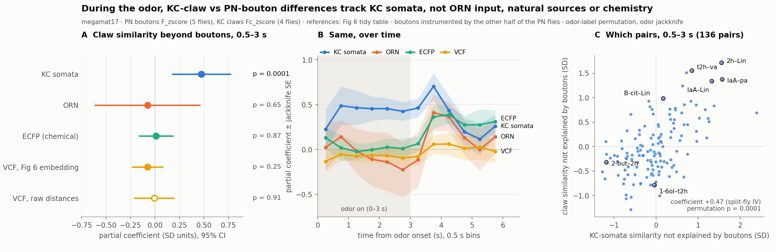
Holding boutons fixed, claw similarity tracks the KC somata
WHAT IT TRACKS
claws ~ boutons + reference | coef | p
KC somata | +0.48 | 0.0001
Hemibrain-wiring model | +0.30 | 0.003
Uniform-wiring model | +0.09 | 0.58
ORN terminals | −0.08 | ns
Somata + hemibrain jointly | +0.42 / +0.13 | 0.0002 / 0.16
Split-fly IV (previous slide), 0.5–3 s, z-scored pair vectors; jackknife SE ≈ 0.15 for somata; leave-one-odor-out range 0.34–0.52.
The somata were recorded in other flies and other windows, yet they explain claw structure that boutons do not. The component is present at 0.5–1 s (+0.51), flat through the odor, and is what somata inherit: predicting somata from boutons and claws, claws carry the weight (+0.81 vs +0.13).
Figure 7 analysis review · 10 · report §3.3
Section 2 of 6 · Is it real, and what it tracks
Notes:
Reference matrices are static (orn_remy; kc_remy_combo; uniform_tom; hemibrain_wd20_tom). Chemistry (ECFP) and natural-source (VCF) distances have coefficients at zero in the same model. Switching the somata reference to the 4-fly kc_remy lowers the somata coefficient by about 15–20% (0.48 → 0.40) and leaves every conclusion (slide 21).

Slide 11
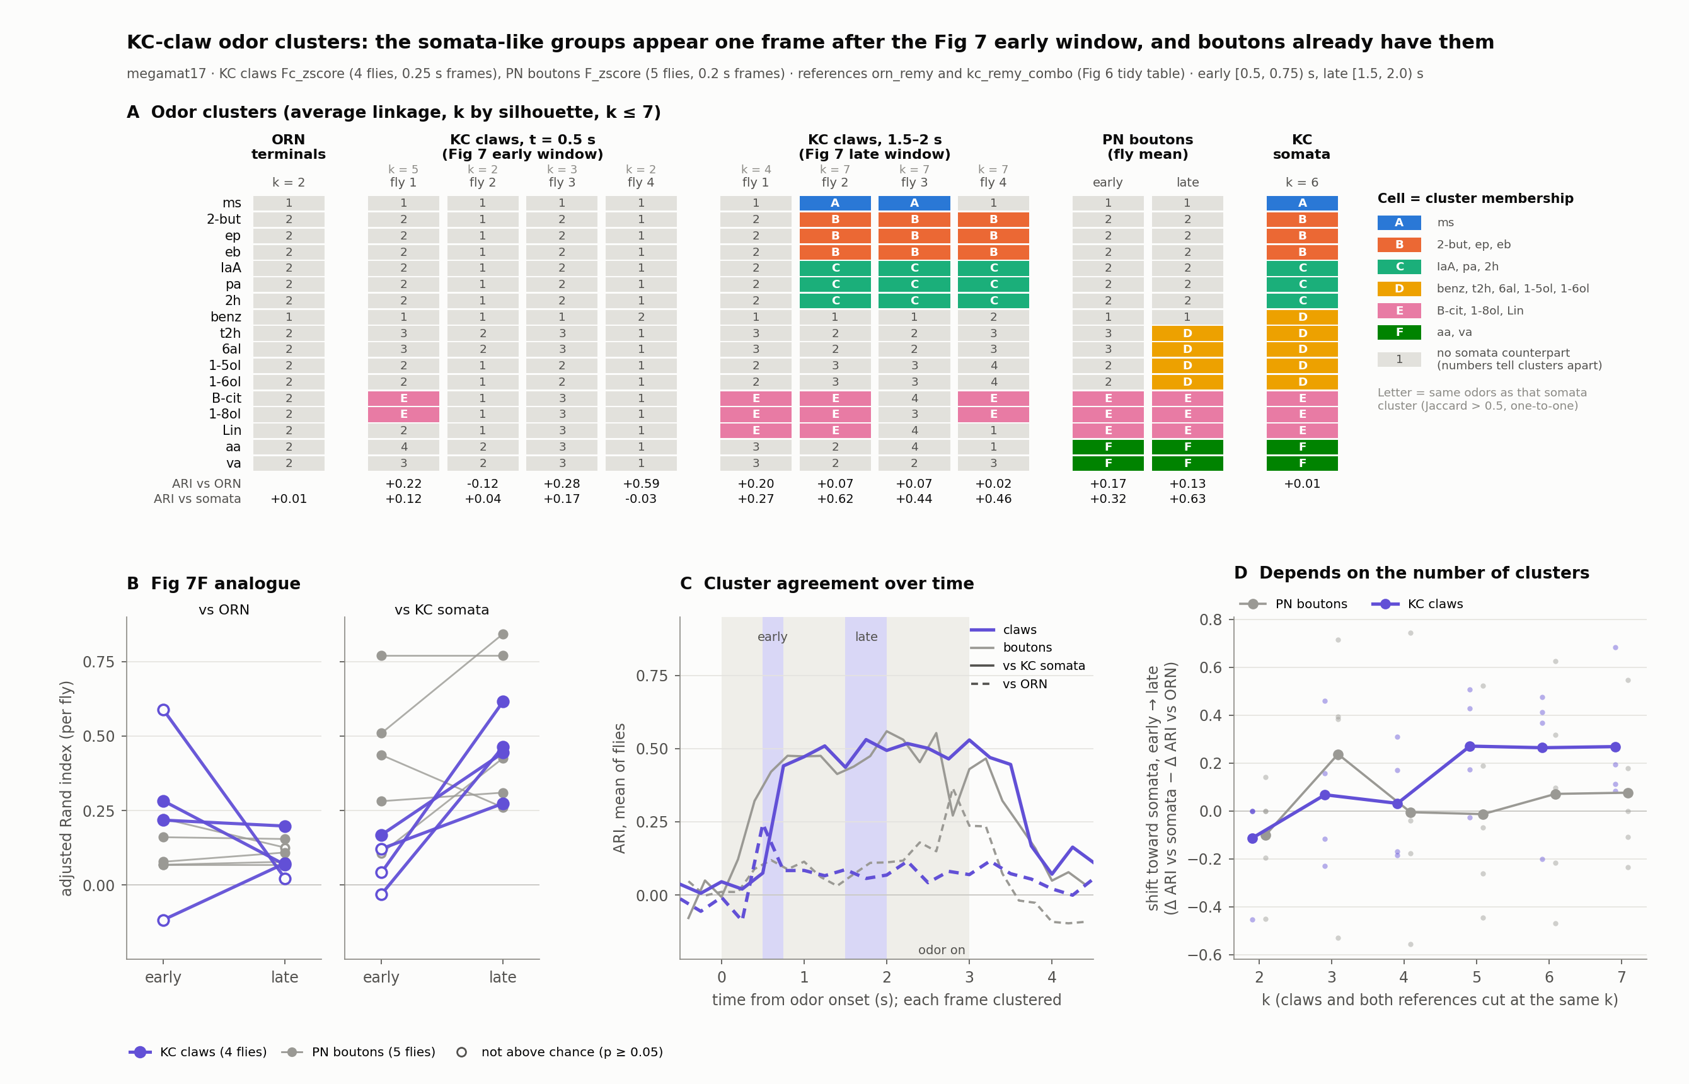
Claw clusters become somata-like early; the ORN side is weaker
WHEN
Figure S7B. Per fly: average linkage on the window matrix, k by silhouette (2–7); ARI vs the ORN clusters (k = 2) and somata clusters (k = 6). Early [0.5, 0.75) s, late [1.5, 2.0) s.
ARI, mean of 4 flies | early | late
vs KC somata | 0.07 | 0.45 (rises 4/4)
vs ORN | 0.24 | 0.09 (falls 3/4)
What drives it: coarse partitions at 0.5 s (one group plus outliers); one frame later the somata groups appear and ARI holds at ~0.45. The 0.5 s frame is reliable (split-half 0.80) but broadly correlated (mean r 0.38).
Matched k: with claws and both references cut at the same k, the somata rise holds at every k; relative shift at k = 5–7: +0.27 in claws vs ≤ +0.08 in boutons.
Figure 7 analysis review · 11 · report §3.4
Section 3 of 6 · When the structure appears
Notes:
Caveat to say out loud: ARI rewards partitions of similar size, and the ORN reference is only k = 2 (benz + ms vs the rest), so “ORN-like early” mostly means “coarse early”. The somata-side rise survives a within-fly trial bootstrap (P ≥ 0.94 per fly); the ORN-side fall survives it in only one fly. The Results draft’s “every fly shifted with respect to both references” holds for somata, not ORN, in these files.

Slide 12
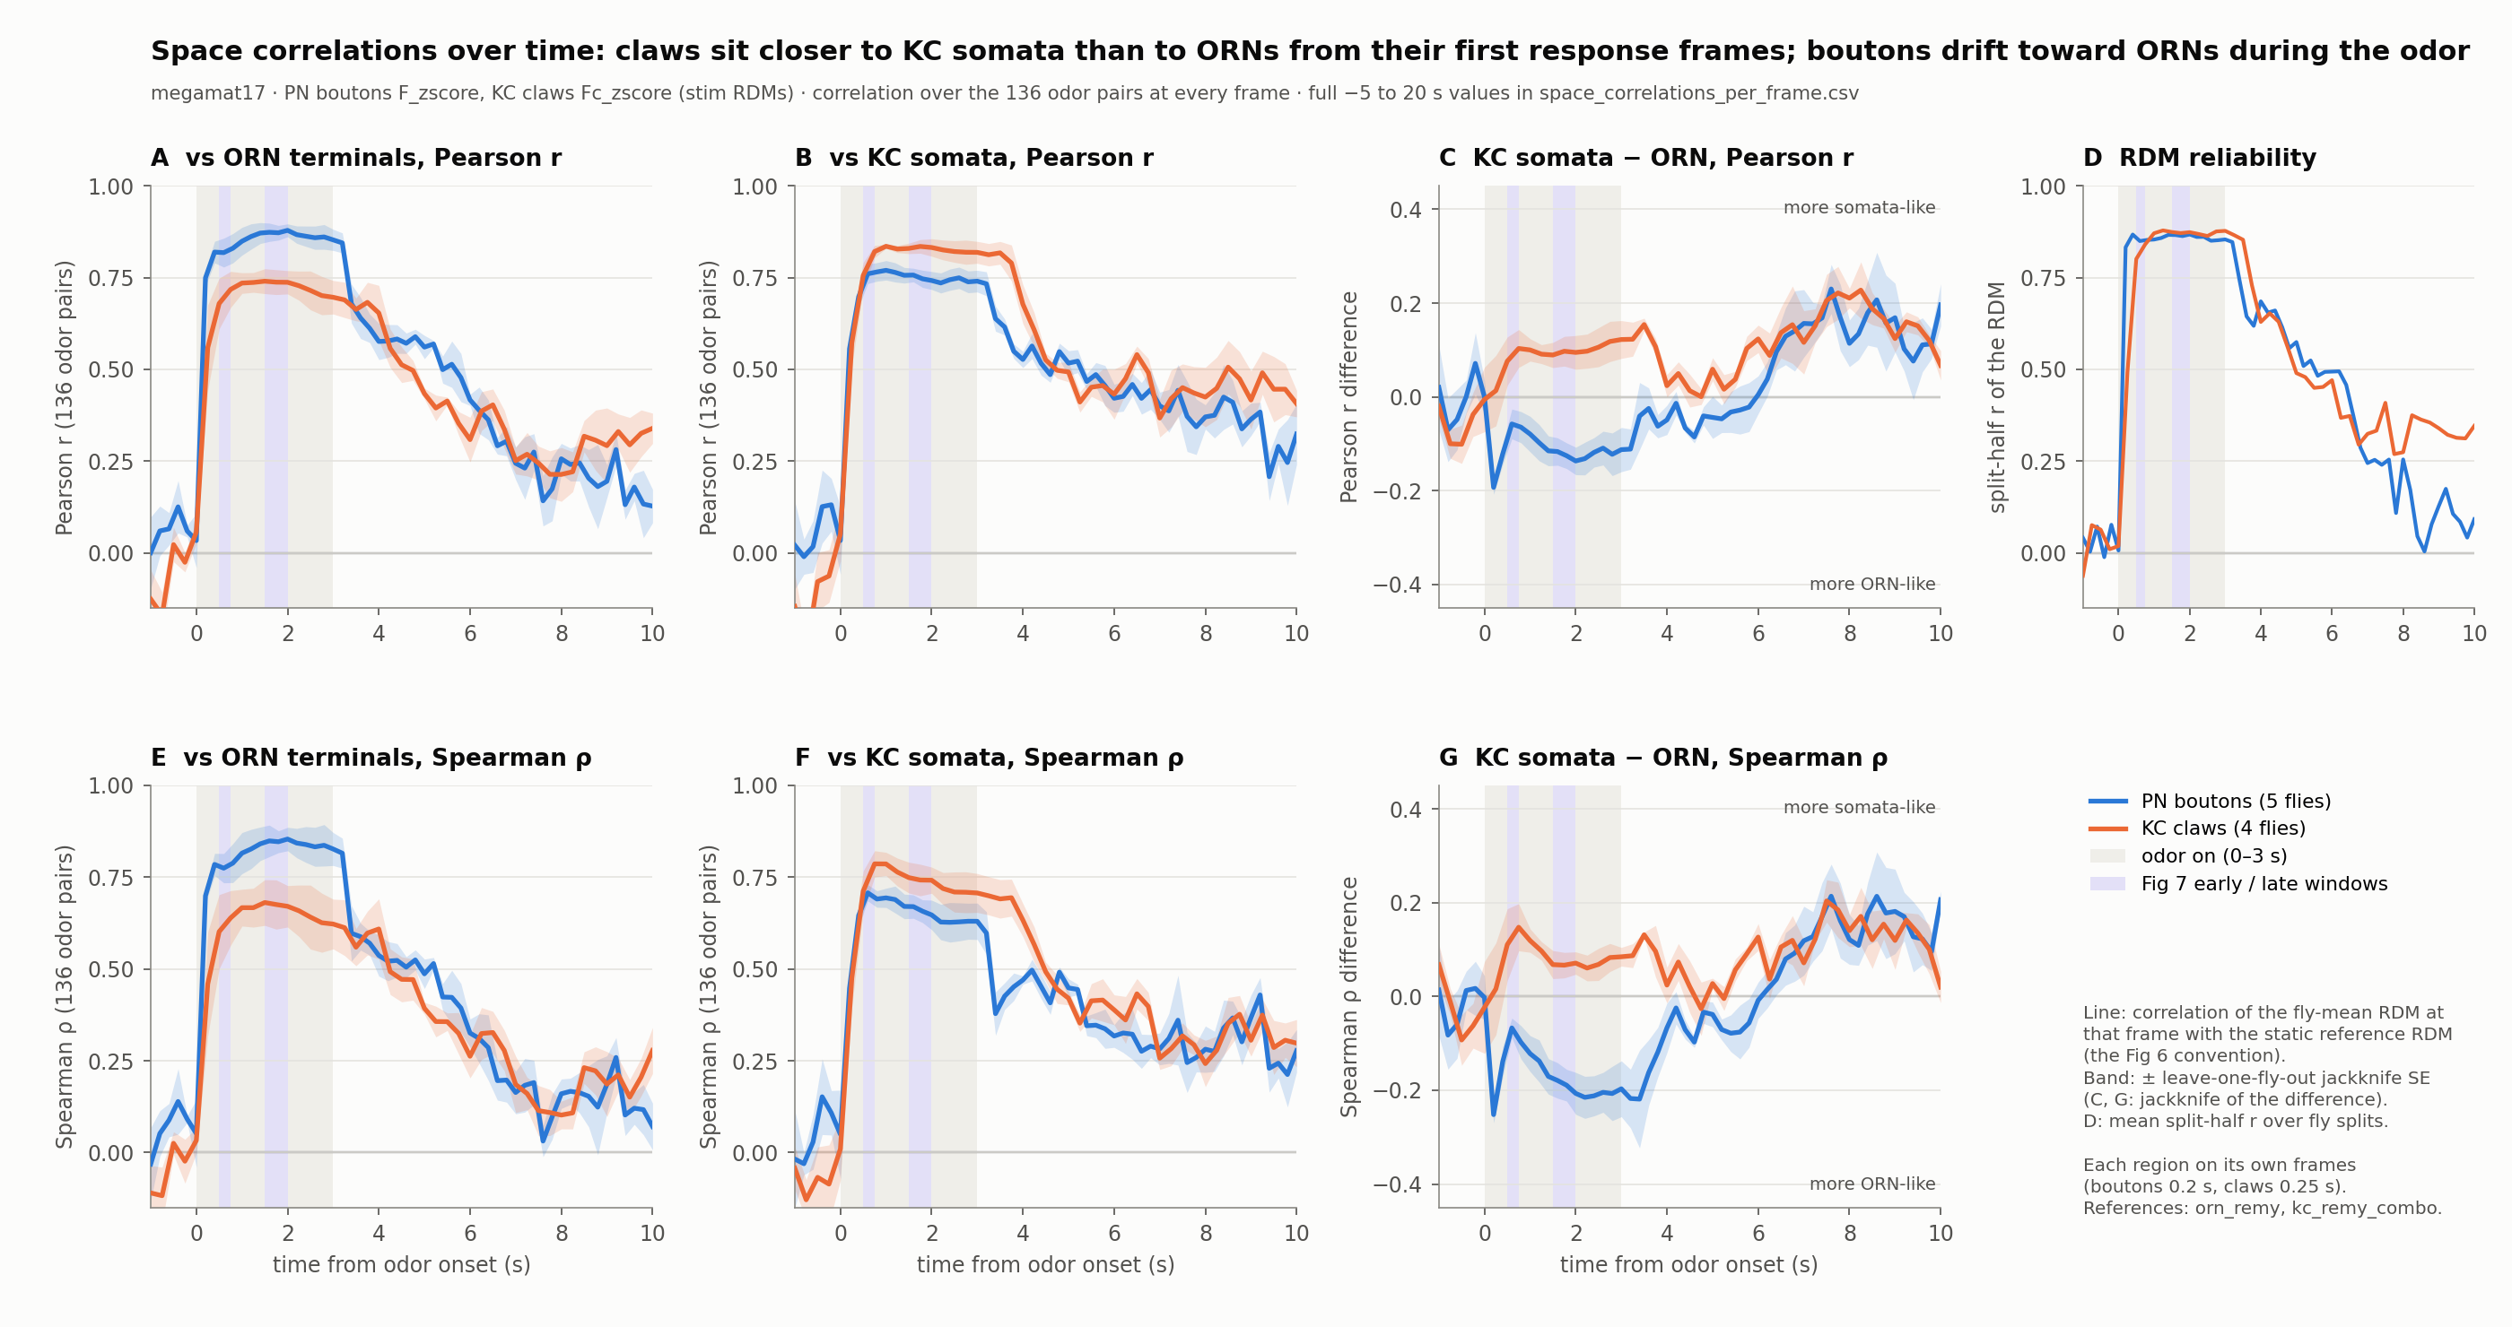
Claws are somata-like from the first reliable frame; boutons drift toward ORN
WHEN
Figure 6’s statistic at every frame: ρ between each region’s fly-mean matrix and the static ORN and somata matrices; leave-one-fly-out jackknife SEs.
ρ somata − ρ ORN | 0.5–0.75 s | 2–3 s
KC claws | +0.11 → +0.15 | +0.07 to +0.09
PN boutons | −0.07 (0.6 s) | −0.20
Claws sit closer to somata than to ORN at every reliable frame from 0.5 to 4 s; the margin peaks at 0.75 s and after offset. Boutons move toward ORN during the odor (ρ ORN 0.77 → 0.85, 0.6 → 2 s).
Nothing builds up over seconds: the somata-like geometry is in place one frame after the first reliable one. Pearson and Spearman agree.
Figure 7 analysis review · 12 · report §3.5
Section 3 of 6 · When the structure appears
Notes:
Reliability gate: frames whose split-half RDM reliability is below 0.5 (before 0.5 s in claws, after ~6 s in both) are not interpreted. From about 6 s on both regions read somata-leaning, but that is noise. The difference somata − ORN is jackknifed as a single quantity, since the same flies enter both terms. Margin in claws is smallest at 1.5–2 s, where the ORN correlation has its late peak.

Slide 13
Fast shared decorrelation, larger in claws
WHEN
different-odor r
same-odor r (reliability)
similarity, noise divided out
What it is
÷
=
A component shared by every odor at onset, fading over about 1 s in both compartments. It changes the level of similarity, not which pairs are similar.
PN boutons 0.38 → 0.27 → 0.26
KC claws 0.46 → 0.27 → 0.22
What it is not
τ 0.52 s (boutons), 0.66 s (claws)
Not the claw-specific pattern (present at 0.5 s and flat) and not a loss of signal: reliability is divided out.
first frame
1.5 s
3 s
Figure 7 analysis review · 13 · report §3.6
Section 3 of 6 · When the structure appears
Notes:
Bars: between ÷ within ratio, mean of flies; first reliable frame 0.4 s (boutons) and 0.5 s (claws); 1.5–1.6 s; 3.0 s. Bar heights are to scale. Same-odor r, peak → 3 s: boutons 0.75 → 0.68, claws 0.72 → 0.56. The ratio is computed per fly and averaged; undefined before the response (same-odor r below 0.05). The τ values come from the explainer page’s live fit (ratio = a + b·exp(−(t − t0)/τ), first reliable frame to 3 s); the report rounds both to “≈ 0.5 s”, which is at the resolution limit of 0.2–0.25 s frames and the indicator. Rank geometry survives the decorrelation (previous slide). Claw reliability also declines over the odor more than bouton reliability, and odor-specifically.

Slide 14
Two ways similarity can change: odor shift vs pair shift
WHICH PAIRS · HOW TO READ A CHANGE
A
B
C
D
E
A
B
C
D
E
A
ODOR PART
A
PAIR PART
B
Odor C moves toward every odor
B
B and D become more alike
C
Its whole row and column change together. One number per odor: aC.
C
One cell and its mirror change; nothing else does.
D
D
E
E
In the data both happen at once. Fitting rij ≈ ai + aj to all 136 pairs pulls out the odor part; what the fit leaves is the pair part. Orange = more similar in claws than boutons predict.
Figure 7 analysis review · 14
Section 4 of 6 · Which pairs move, and the wiring models
Notes:
A toy with five odors, not data. An odor shift is one odor’s population vector moving toward or away from the whole cloud, for example a component it shares with every odor; a pair shift is two odors gaining KCs that respond to both and little else. In claws the pair part is 60–67 % of the change and stable over the odor; the odor part is 32–40 % and drifts. The next slide shows the same split on the real matrix.

Slide 15
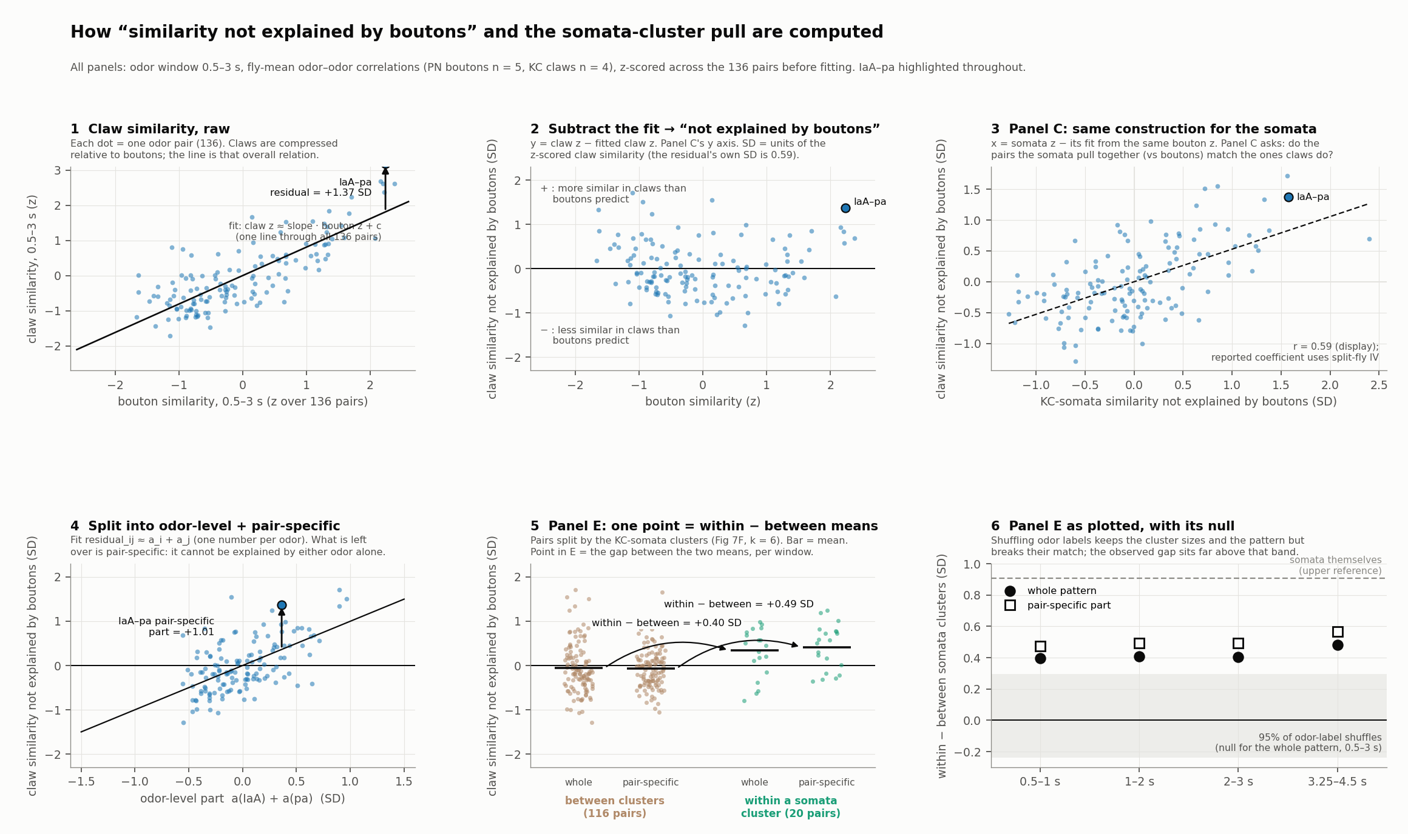
Claws beyond E[claws | boutons], split into an odor part and a pair part
WHICH PAIRS
Residual
z(claw r) − linear prediction from z(bouton r), per window, across the 136 pairs. Units: SD.
Odor part
Least-squares fit rij ≈ ai + aj: one effect per odor, its pull on all others. 32–40% of the residual variance.
Pair part
What is left: two odors moving together beyond what either does with everyone. Reproducible (split-half r ≈ 0.6, p 0.002).
Figure 7 analysis review · 15 · report §3.8
Section 4 of 6 · Which pairs move, and the wiring models
Notes:
Population-vector reading: an odor-part shift is one odor’s vector moving toward or away from the whole cloud (a shared-axis component, or reliability); a pair-part shift is two odors gaining claws that respond to both and little else. The additive model is a 17-parameter fit on 136 values; its identifiability with 16 pairs per odor is one of the questions for the theory side.

Slide 16
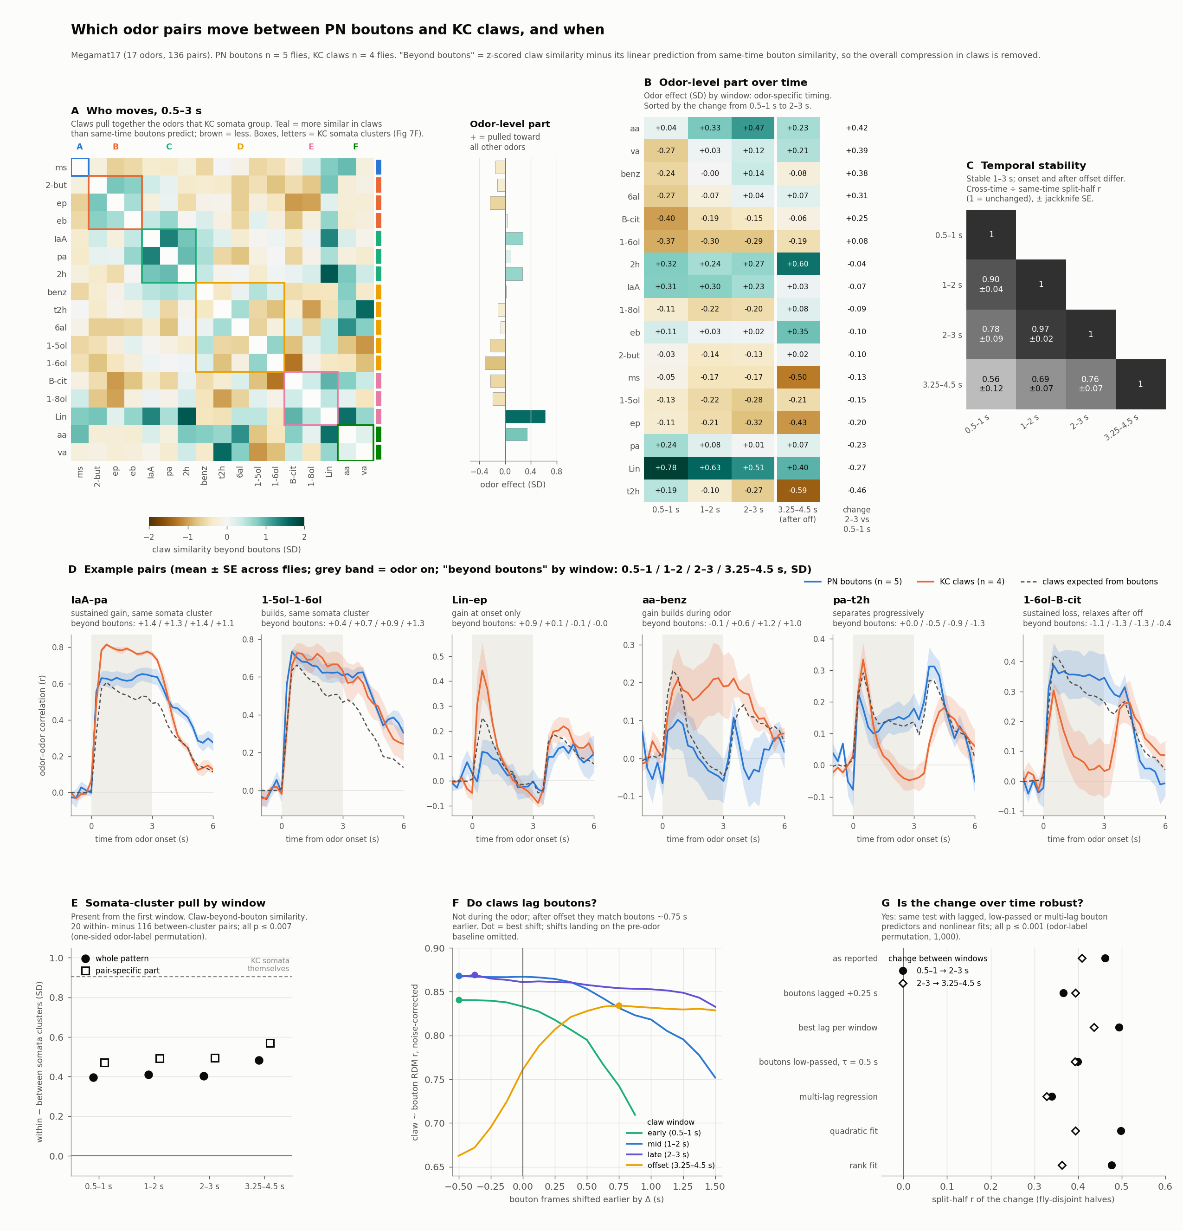
A stable pair part and a slowly drifting odor part
WHICH PAIRS
0.91–0.98
Pair part is stable across odor windows (noise-corrected); it matches the somata (r 0.65–0.71).
62 %
of the early → late change is odor part. The change replicates across fly halves (r 0.46, p 0.001).
9 of 10
top movers move the same way in the somata.
Figure 7 analysis review · 16 · report §3.8
Section 4 of 6 · Which pairs move, and the wiring models
Notes:
Other numbers (0.5–3 s): reproducibility across fly halves r 0.56–0.60 in every window; within − between somata-cluster pairs +0.49 SD (p 0.0003); odor-part stability early × late 0.50. Odor-specific timing (0.5–1 → 3.25–4.5 s): Lin fades +0.78 → +0.40; aa builds +0.04 → +0.47 by 2–3 s (+0.23 after offset); t2h separates +0.19 → −0.59; B-cit starts distinct and relaxes −0.40 → −0.06. Not kinetics: best bouton lag during the odor ≤ 0; the change survives lag, low-pass, multi-lag, quadratic and rank controls (split-half r 0.34–0.50, all p 0.001). Top gains (SD): 2h–Lin +1.71, t2h–va +1.55, Lin–aa +1.51, IaA–pa +1.37; top losses 1-6ol–B-cit −1.28, 1-5ol–va −1.06. Four of the top six gains are pairs boutons keep near r ≈ 0.1 that claws bring to 0.24–0.38: similarity created, not just preserved. Temporal stability = cross-time split-half r ÷ geometric mean of same-time split-half r’s, so noise is not counted as change. The windows share boundary frames; half-open windows give the same picture.

Slide 17
The pair part is partly predicted by either wiring model; only the odor part carries the hemibrain-specific bias
WHICH PAIRS · CONNECTIVITY MODELS
Claws beyond E[claws | boutons] vs … | 0.5–1 s | 1–2 s | 2–3 s
Pair part: hemibrain model | 0.29 | 0.32 | 0.37
Pair part: uniform model | 0.23 | 0.26 | 0.31
Pair part: hemibrain − uniform | 0.14 ns | 0.14 ns | 0.14 ns
Odor part: hemibrain − uniform | 0.21 ns | 0.54 (p 0.02) | 0.62 (p 0.008)
Each model residualized on same-window boutons, split into the same two parts. The models’ pair-part predictions overlap (r 0.58), so the share they predict (r 0.23–0.37, against a reliability ceiling ≈ 0.78) is what any PN → KC expansion produces; most of the reliable pair part is predicted by neither.
What the connectome prior adds shows up only in the odor part, during the sustained odor: 0.21 → 0.54 → 0.62, then 0.17 after offset.
Added value for claws beyond E[claws | boutons]: uniform model R² 0.05 → + (hemibrain − uniform) 0.16 (p 0.001), almost all at the odor level (odor values R² 0.02 → 0.46). Claws could follow the pair part of the difference (reliability ceiling ≈ 0.78; somata reach 0.69) but mostly don’t (0.13–0.16).
Figure 7 analysis review · 17 · report §3.8.1, §3.8.3
Section 4 of 6 · Which pairs move, and the wiring models
Notes:
Model RDMs: uniform_tom and hemibrain_wd20_tom (Figure 6’s “uniform” and “hemibrain”); one response per odor, so static. The static-wiring account can still produce a window-dependent match: the bias acts through whichever PNs are active, and which PNs are active changes over the odor.

Slide 18
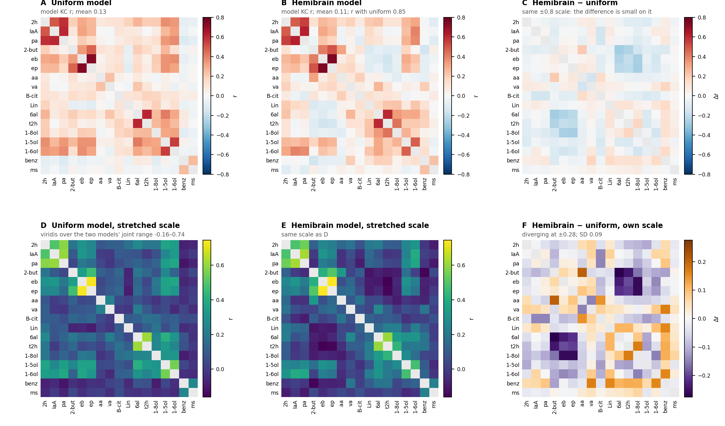
Hemibrain − uniform: a few odors re-weighted, and one ester × aldehyde block pushed apart
WHICH PAIRS · WHAT THE CONNECTOME PRIOR ADDS
r(uniform, hemibrain) = 0.85. The difference (SD 0.09) is 33–36% odor part, 64% pair part; the pair part is concentrated (top 10 pairs = 48% of its variance).
Odor part: benz, Lin, va pulled toward the other odors; 2-but, eb, ep, 1-5ol pushed away.
Pair part: {2-but, eb, ep} × {6al, t2h, 1-8ol} pushed apart (the eight most negative cells, −0.19 to −0.28); 2-but–aa, 1-8ol–t2h, aa–B-cit pulled together.
Not a curvature of the uniform model (quadratic adds R² 0.02); not organized by somata cluster (p 0.14) or chemical class (p 0.52).
Figure 7 analysis review · 18 · report §3.8.3
Section 4 of 6 · Which pairs move, and the wiring models
Notes:
Figure: 9_model_difference/model_heatmaps.png. Top row: the usual RdBu_r ±0.8 scale on which the difference is nearly invisible. Middle row: a shared stretched scale for the two models and a diverging scale at ±0.28 for the difference. The uniform model is nearly a function of the ORN RDM (r 0.97; a convex one); the hemibrain model departs from ORN (r 0.79), and that departure is the difference pattern.

Slide 19
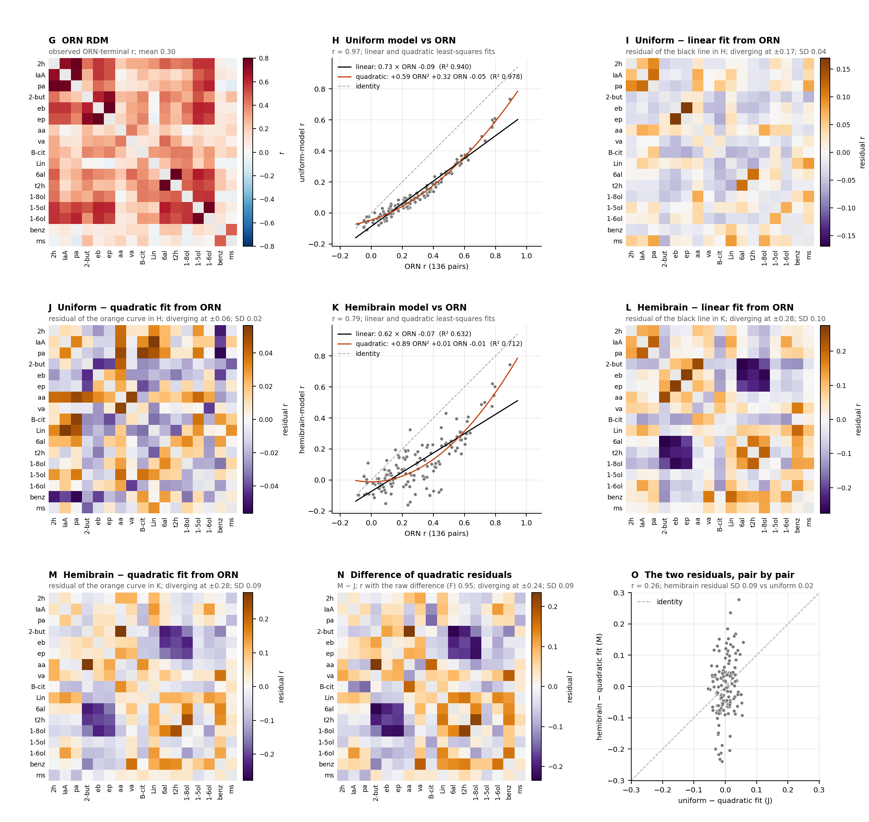
Claws follow the prior’s odor part and its ester–aldehyde block, not its specific links
WHICH PAIRS · DO CLAWS FOLLOW THE PRIOR?
Claws vs the model difference | 0.5–1 | 1–2 | 2–3 | 3.25–4.5 s
r of the 17 odor values | 0.21 | 0.54 | 0.62 | 0.17
Ester × aldehyde block, claws beyond E[claws | boutons] (SD) | −0.31 | −0.46 | −0.58 | −0.66
Block permutation p (one-sided) | 0.10 | 0.012 | 0.003 | 0.008
Pair-part r (all cells) | 0.14 | 0.14 | 0.14 | 0.16
Agree throughout: Lin (+) and the pushed-away set 1-5ol, ep, 1-8ol, B-cit.
Move into agreement: benz (−0.24 → +0.14), va (−0.27 → +0.12), t2h (+0.19 → −0.27). Never agree: 2h, eb, aa.
The specific links go the wrong way: 2-but–aa and 1-8ol–t2h are negative in claws in every window (2-but–aa in somata too, −0.72). Block mean, 0.5–3 s: −0.49 SD (p 0.009 one-sided; pair part −0.25, p 0.04); in somata −0.53 (p 0.012).
Figure 7 analysis review · 19 · report §3.8.3
Section 4 of 6 · Which pairs move, and the wiring models
Notes:
Lower rows of the figure: removing each model’s own quadratic curve on ORN barely changes the difference (r 0.95 with the raw difference), and the two models’ residuals share only r 0.26 pair by pair, with the hemibrain residual four times larger. So what separates the models is not a function of ORN similarity. Sign agreement on the 20 largest cells of the difference (cell-level check of October 19), by window: 12, 14, 16, 15; descriptive only. Because the block cells share odors, the block was tested by odor label: its mean was compared with every block of two disjoint odor triples (123,760). The block was chosen from the model difference, not from claws. Its growth from early to late (−0.27, p 0.08) is mostly odor part (pair part −0.06, p 0.23).

Slide 20
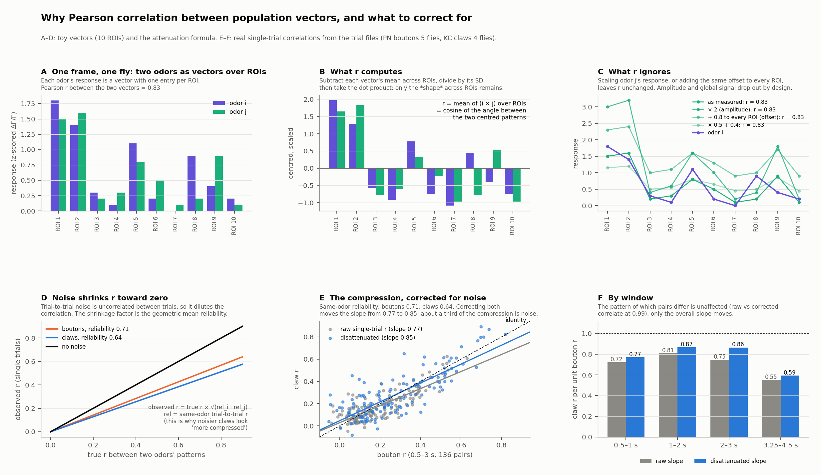
Why Pearson r per frame, and the one bias it has
CHECKS
r centres and scales each odor’s ROI vector, then takes the dot product: pattern similarity, blind to amplitude and shared offsets. It is the hypothesis’s quantity, it matches the static references, and claws and boutons keep the same units, so a slope is the compression.
Attenuation: observed r = true r × √(reli relj); same-odor single-trial reliability 0.71 (boutons), 0.64 (claws).
Compression slope | raw | disattenuated
0.5–3 s | 0.77 | 0.85
by window | 0.72 / 0.81 / 0.75 / 0.55 | 0.77 / 0.87 / 0.86 / 0.59
About a third of the apparent compression is noise. The pair pattern is unchanged (raw vs corrected r 0.99), so no pair-level result moves.
Figure 7 analysis review · 20 · report §3.2, §5
Section 5 of 6 · Checks on the statistics
Notes:
Fitting correlations on correlations is fine as a descriptive regression; the inference does not treat the 136 pairs as independent (odor-label permutation) and the regressor noise is handled by the split-fly IV. Spearman and Fisher-z variants of the main results agree with Pearson (§3.8.2). The “claws ≈ 0.80 × boutons” on slide 7 is from fly-mean matrices; the 0.77/0.85 pair is from single trials, where reliability is defined. If a compression number goes in the paper, 0.85 is the defensible true value and 0.77–0.80 the observed one.

Slide 21
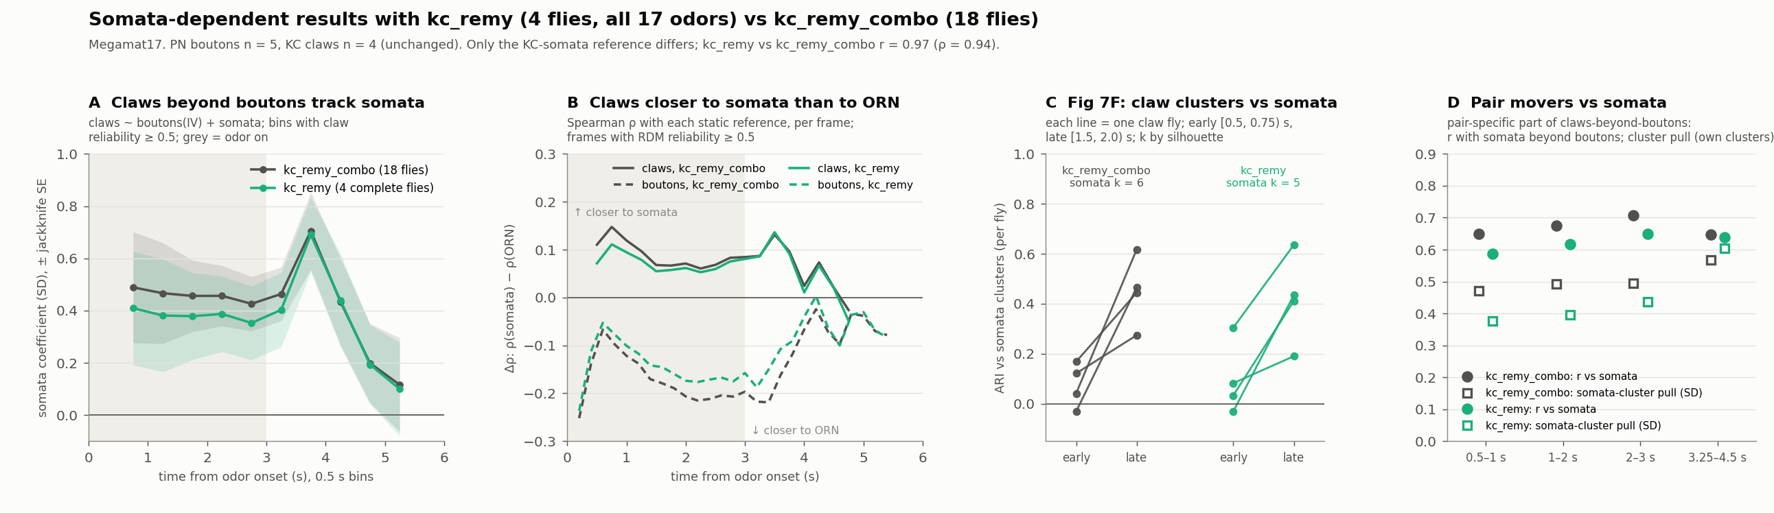
Robust to the somata reference and to the fit scale
CHECKS
18-fly → 4-fly somata reference
Scale and fit, 0.5–3 s
The two matrices correlate at r 0.97. Somata coefficient 0.48 → 0.40; pair part vs somata 0.65–0.71 → 0.59–0.65. Effects about 15–20 % smaller; no conclusion changes.
Scale | Split-half | vs somata | Pair part | Odor part
Pearson | 0.57 | 0.59 | 0.69 | 0.54
Fisher z | 0.56 | 0.59 | 0.71 | 0.56
Ranks | 0.56 | 0.55 | 0.63 | 0.49
Quadratic | 0.52 | 0.47 | 0.62 | 0.51
Figure 7 analysis review · 21 · report §3.8.2, §3.10
Section 5 of 6 · Checks on the statistics
Notes:
References: kc_remy_combo (18 flies) and kc_remy (4 flies). With the 4-fly reference p for the somata coefficient goes 0.0001 → 0.0002, the cluster pull +0.49 → +0.41, and the Figure S7B somata ARI still rises in 4 of 4 flies. Table columns: split-half r of claws beyond E[claws | boutons]; that pattern vs somata; pair part vs somata; odor part vs the model difference. Top movers kept: 10, 9 and 7 of 11 (Fisher z, ranks, quadratic). Two shifts with the 4-fly reference worth knowing: the hemibrain model keeps some weight in the joint model (+0.19, p 0.04 instead of ns), and the quadratic check is weaker (+0.27, p 0.02). Whether the smaller effects reflect a noisier 4-fly average or the older flies making kc_remy_combo more claw-like cannot be separated from averaged matrices.

Slide 22
The statistical toolkit, in one table
CHECKS
Problem | What we do | Where it enters
Pairs not independent (16 per odor) | Odor-label permutation; Freedman–Lane for partial coefficients; leave-one-odor-out jackknife SEs | every p and SE on pair-level correlations
Regressor measured with noise | Split-fly instrumental variable (exactly identified 2SLS, 20 fits) | claws ~ boutons + reference; somata ~ boutons + claws
No within-animal pairing | Fly-disjoint halves, PN 2 | 3 × KC 2 | 2 = 30 splits; sign consistency per pair | §3.2, §3.8 pattern, parts, early → late change
Noise counted as change | Cross-time split-half r ÷ geometric mean of same-time split-half r’s | temporal stability, §3.8
Level vs geometry; attenuation | Between ÷ within trial r; disattenuation by √(reli relj); reliability control on odor values | §3.6; §3.2 slopes; §3.8 odor part
ARI granularity bias | Matched-k comparison; within-fly trial bootstrap of the blockavg RDM (1,000 draws) | §3.4
Kinetic confounds | Bouton lag scan, causal low-pass, multi-lag regression; quadratic and rank fits | §3.8 early → late change
Every JS port in the explainer page was checked against the Python outputs: IV coefficients and jackknife SEs to 3 dp, Welch t to 1e-10, cluster/ARI rows exactly, per-frame correlations to the export’s rounding.
Figure 7 analysis review · 22 · report §5
Section 5 of 6 · Checks on the statistics
Notes:
Software: Python 3; numpy, scipy, pandas, xarray, scikit-learn, matplotlib. Scripts are in Figure-07/code/ (logs in code/logs/, outputs in outputs/results/); an independent from-scratch recomputation matched every headline pair-movers number to 3 dp.

Slide 23
Each question, the answer the data gave, and what it ruled out
SUMMARY · FINDINGS TREE
QUESTION
ANSWER
RULED OUT
1
Do claws differ from boutons beyond compression and noise?
Yes: the extra pattern reproduces across fly halves (r 0.56–0.60)
Claws inherit boutons
2
The KC somata: IV +0.48 (p 0.0001), +0.43 to +0.49 in every 0.5-s bin
Inherited input noise (ORN −0.08)
What does the extra structure track?
3
When does it appear?
From the first reliable frame (0.5 s), stable to 3 s (0.91–0.98)
Builds during the odor
4
A fast shared decorrelation (τ ≈ 0.5 s) and a slow odor-part drift (62 % of early → late)
Pairs re-sort over the odor
Then what changes over time?
5
Pair part 60–67 % and odor part 32–40 %, plus the shared decorrelation
One undifferentiated change
How does the extra pattern split?
Pair part · stable
Odor part · drifts
Shared decorrelation
Partly predicted by either wiring model (r 0.23–0.37), not by their difference; matches the somata (r 0.65–0.71)
Follows hemibrain − uniform during the sustained odor (0.54–0.62); the drift is a slow gain change, not APL
A common onset component fading, upstream or presynaptic; claws lose about twice as much as boutons
Figure 7 analysis review · 23
Section 6 of 6 · Summary, caveats and open questions
Notes:
The whole analysis on one slide, in the order it was done. Checks that every row survives: no lag or low-pass explains it; Pearson justified and attenuation corrected; holds on Fisher z, ranks and quadratic fits (within 0.07) and with the 4-fly somata reference. Full version with the files behind each step: the Figure 7 findings tree page.

Slide 24
The path the labmate's APL matrices take
BEYOND FIGURE 7 · APL ON VS OFF · EXPLORATORY
QUESTION
HER MATRICES
OTHER BRANCH WOULD MEAN
1
Does silencing raise between-odor similarity?
Yes: mean r 0.19 → 0.39; acetate × ester 0.12 → 0.40
Silencing did not take: check data
2
Is the matrix shape kept?
Yes: Spearman 0.86, Pearson 0.93
Inhibition rebuilds the geometry
3
Which part carries the change?
Odor terms, 62 %; they follow the claws' odor part (r +0.82), not its drift
Inhibition re-sorts pairs
4
Do the odor terms track each odor's drive?
Not testable yet: no drive measure
No: odor-selective inhibition
5
Does the residual keep the control's signs?
Yes, rescaled: 95 % agree, r 0.97; claws' pair part untouched (r 0.03)
Structured inhibition
6
Where between claws and somata does APL act?
On the pairs the somata separate (r −0.60); about half that step (slope 0.98 → 0.55)
Threshold alone sharpens
7
Is the silenced RDM closer to ORN?
Yes: 0.73 → 0.80 (Spearman 0.78 → 0.85)
Reformatting is feedforward
Inhibition plus the spike threshold sharpen the somata; the somata read a linearized claw code.
The claws' pair part is wiring, scaled by inhibition. Averaged matrices, 12 odors: a split-half check across her flies would make it a result.
Figure 7 analysis review · 24
Section 6 of 6 · Summary, caveats and open questions
Notes:
Labmate's KC somata, APL intact vs silenced, on the 12 odors we share (66 pairs). Her control matches our static somata (r 0.93). Exploratory and not a paper claim; in the paper APL stays two Discussion sentences from the literature. Numbers: apl_labmate_matrices/outcome_path.csv and Discussion answers §8b, §8d, §11.

Slide 25
What limits the claims
CAVEATS
Small samples, different animals
The claw ROI mask
4 claw flies, 5 bouton flies, no within-animal pairing. Per-pair tests have little power; odor-level and population-level statistics carry the conclusions.
Whether claw ROIs exclude somata-level signal is unconfirmed; the “KC-level signal in claw calcium” reading depends on it, and on claws weighting glomeruli like GH146 boutons.
Static references from elsewhere
Post-offset and kinetics
ORN and somata matrices come from other flies and other response windows; the models give one response per odor. Time-matched references could change the early/late picture (one fly imaged at both: somata stationary, r 0.87–0.91 with the reference).
After offset, claws hold odor-period structure ~0.75 s longer than boutons, and both show an odor-nonspecific offset bump, larger in claws (one fly: ~5 % of claws, no somata). Post-offset changes are partly kinetic and not leaned on.
17 odors
Mechanism is a hypothesis
Odor-level results rest on 17 values; one odor can move a per-window correlation by 0.1–0.2. Leave-one-odor-out ranges are reported for the main coefficients.
The data localize and time the transformation; they do not distinguish structured calyx inhibition from non-uniform PN–KC weights or centrifugal input.
Figure 7 analysis review · 25 · report §6
Section 6 of 6 · Summary, caveats and open questions
Notes:
Also: the windows share boundary frames (half-open windows give the same stabilities); the first response frame (0.25 s) is unreliable and excluded; frames after ~6 s are unreliable in both regions.

Slide 26
The questions we would like answered
FOR THE THEORY SIDE
Split-fly IV with 2 | 3 flies. Is exactly identified 2SLS defensible at this n, with 136 non-independent observations and a noisy reference? Is the first stage strong enough (bouton RDM split-half r 0.72–0.84)?
Odor-label permutation as the inference unit. With 17 odors, is Freedman–Lane on reduced-model residuals the right null for partial coefficients, and is the leave-one-odor-out jackknife a reasonable SE?
Additive decomposition. rij ≈ ai + aj is a 17-parameter fit on 136 values. Is the odor part / pair part split identifiable enough that “only the odor part carries the hemibrain bias” is sound?
Noise-corrected stability. Cross-time split-half r ÷ geometric mean of same-time split-half r’s: unbiased for true temporal stability, or inflated near 1?
Disattenuation. observed r = true r × √(reli relj) assumes independent additive trial noise. Is applying it to a compression slope (0.77 → 0.85) legitimate, and what are its error bars?
Convexity and the linear residual. The claw-vs-bouton relation is convex (quadratic F 27.8). Does defining “claws beyond E[claws | boutons]” as the linear residual bias which pairs count as movers?
Decorrelation time constants. τ ≈ 0.5–0.7 s at the frame-rate/indicator floor: what, if anything, can be inferred about the underlying process?
Figure 7 analysis review · 26
Section 6 of 6 · Summary, caveats and open questions
Notes:
Also open, less statistical: whether a static wiring model can be expected to give a window-dependent match (slide 17), and whether an odor-label block permutation (slide 19; 0.5–3 s p 0.009 one-sided) is the right null for a block chosen from the model difference.

Slide 27
Where everything lives
TO CHECK THE WORK
The report
The explainer page
Code and data
rdm_timeseries_analysis_report.html: ten sections (3.1–3.10), every table and figure, methods (§5), caveats (§6), reproducibility (§8). Outputs in outputs/results/, one subfolder per section; the report sits in outputs/reports/.
rdm_timeseries_explainers.html: a self-contained page that recomputes §3.1–3.6 and §3.8 in the browser from the per-fly data, with toy examples, port checks against the report, and robustness controls. Tabs 3.7, 3.9, 3.10 deferred until after submission.
Python scripts in code/ (run locally; paths in code/paths.py; RDM_DATA env for another data root). Inputs: the stim and trial RDM NetCDFs for both regions and the megamat17 tidy distance table. The decomposition dashboard (rdm_decomposition_dashboard.html) gives the heatmaps for any time bin.
Ask for any of these; the per-fly data are not in the deck. Comments on specific slides are welcome in the deck itself.
Figure 7 analysis review · 27
Section 6 of 6 · Summary, caveats and open questions
Notes:
The data stay local on request; the report, explainer page and dashboard are files that can be shared directly.

